Slide 1
Gender terms and definitions

Slide 2
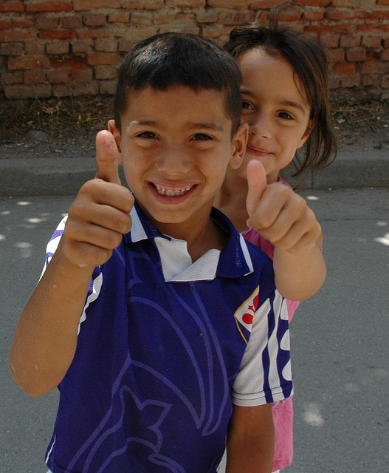
Sex and gender
Sex
Biologically defined and genetically acquired differences between males and females, according to their physiology and reproductive capabilities or potentialities
Universal and mostly unchanging, without surgery
Albanian children
Photo ©2007 by G. Stolarsky/Jhpiego

Slide 3
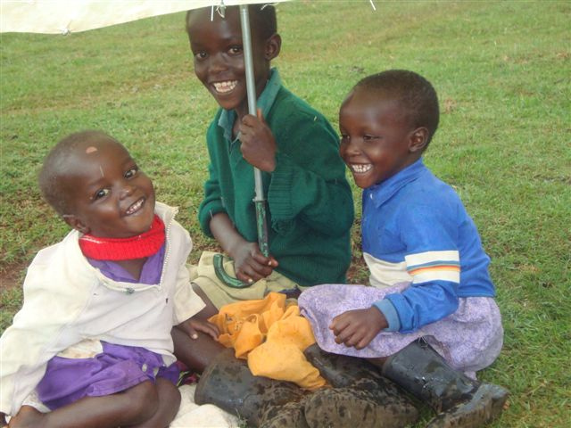
Sex and gender
Gender
Social characteristics associated with being a man or a woman:
economic, social, political, and cultural attributes
opportunities, roles, and responsibilities
Socially constructed, constituted differently across the world, and changing over time
Siblings in Kuresoi, Kenya
Photo ©2009 by George Avosa/Jhpiego
Notes:
Gender refers to a socially constructed set of economic, social, and political roles, responsibilities, rights, entitlements obligations, associated with being female and male, as well as the power relations between and among women and men, boys and girls. Ones’ gender identity may or may not correlate with ones’ sex assigned at birth. The definition and expectations of what it means to be a woman or girl and a man or boy, and sanctions for not adhering to those expectations, vary across cultures, over time, and throughout the life course; they also often intersect with other factors such as race, class, age and sexual orientation.

Slide 4
Gender roles
Behaviors, tasks, and responsibilities considered appropriate for women and men as a result of sociocultural norms and beliefs
Usually learned in childhood
Change over time as a result of social and/or political changes
Notes:
Facilitator discussion points
Gender roles consist of activities that women and men engage in with varying frequency.
Gender roles are usually learned during childhood and can change over time as a result of social and/or political changes.
They often lead to the perception of gender roles as natural, biologically derived, or historically confirmed—and therefore valid. This leads to the creation and perpetuation of gender stereotypes.

Slide 5
Gender stereotypes
Ideas that people have about masculinity and femininity:
what men and women of all generations should be like and are capable of doing
e.g., girls are allowed to cry but boys are expected to be brave and not cry
Notes:
Facilitator discussion points
A gender stereotype consists of beliefs about the psychological traits and characteristics, as well as the activities and behaviors, appropriate for women and men. Whereas gender roles are defined by behaviors, gender stereotypes are beliefs and attitudes about femininity and masculinity.
Gender roles and gender stereotypes are related. When people associate a pattern of behavior with either women or men, they may overlook individual variations and exceptions and come to believe that the behavior is inevitably associated with one gender but not the other. As such, gender roles provide the material for gender stereotypes.
Gender stereotypes are very influential and they establish social categories for women and men. They fulfill the function of maintaining a hierarchical/unequal relationship between women and men. Gender stereotypes change very slowly; this may help to partially explain why gender discrimination persists even though gender roles change.

Slide 6
Gender equality does not mean treating everyone the same
Notes:
Ask: Why is treating everyone the same problematic here?
Explain: Like these animals, people have varying biological but also sociological constraints and advantages that must be accommodated.

Slide 7
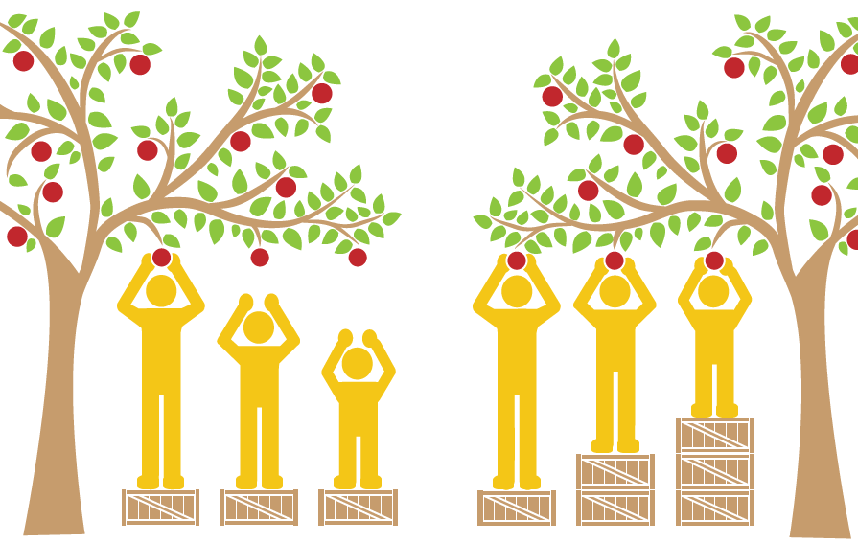
Level playing field => Inequality in outcomes
Equity =>
Equality in outcomes
Image © The Saskatoon Health Region. https://www.communityview.ca/infographic_shr_health_equity.html
Notes:
Facilitator discussion points
Explain that gender equality is the goal. But to reach that goal, sometimes you have to treat people differently, or distribute resources that are not perfectly equal, to make up for disadvantages that individuals may have biologically or because of inequities of the past. For example, in many societies, women do not have the same opportunities for education because of higher preference for the boy child. Thus, girls are often not able to advance educationally, economically, and so forth.
In the first illustration, the three people are given the same size boxes despite their different heights, and the only person able to reach the apple on the tree is the tallest person. This illustration displays inequality in outcomes (reaching an apple on the tree) because boxes were not tailored to the capacities of the individuals (their differing heights). In the second illustration, boxes are equitably distributed and are tailored to the capacities of the individuals (the shortest person has the tallest box), and therefore there is equality since all three people are able to reach the apples.

Slide 8
Gender equality and gender equity
Gender equality is the GOAL.
Ability of men and women to have equal opportunities and life chances
It does NOT mean that resources or benefits must be split evenly between men and women
Gender equity
Processes used to achieve gender equality
Fairness in representation, participation, and benefits
Women and men have a fair chance of having their needs met:
equal access to opportunities for realizing their full potential

Slide 9
Gender integration and gender mainstreaming
Gender integration
Strategies applied in programmatic design, implementation, monitoring, and evaluation to take into account gender considerations and compensate for gender-based inequalities
Gender mainstreaming
Process of incorporating a gender perspective into an organization’s:
policies, strategies, and administrative functions
institutional culture
At the organizational level, ideally results in meaningful gender integration
Notes:
Facilitator discussion points
Gender mainstreaming could include things like gender sensitivity training for staff, offering family leave and flex work policies to recognize caregiving roles, and offering breastfeeding or childcare centers.

Slide 10
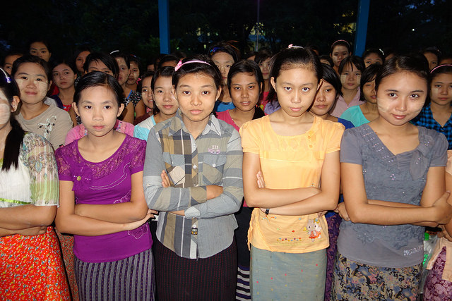
Women’s empowerment
Expansion of women’s capacity to make and act upon decisions (agency) and to transform those decisions into desired outcomes, affecting all aspects of their lives, including health
Entails overcoming socioeconomic and other power inequalities in a context where this ability was previously denied
Pyay Nursing and Midwifery School, Myanmar, Photo ©2015 by Ann Lolordo/Jhpiego
Notes:
Facilitator discussion points
Read the information on the slide.

Slide 11
Male engagement
Programmatic approach that involves men and boys as clients and beneficiaries, as partners, and as agents of change in actively promoting:
gender equality
women’s empowerment
transformation of inequitable definitions of masculinity
Engages men and boys in addressing their own, and supporting their partners’, reproductive, sexual, and other health needs
Includes broader efforts to promote equality with respect to caregiving, fatherhood, division of labor, and ending gender-based violence
Father and baby, Donomulyo Village, Indonesia
Photo ©2009 by Karen Kasmauski/Jhpiego
Notes:
Facilitator discussion points
Read the information on the slide.

Slide 12
Gender-based violence
Violence directed at individuals based on their biological sex, gender identity, or perceived adherence to culturally defined expectations of what it means to be a woman and man, girl and boy
Includes public or private:
physical, sexual, and psychological abuse
threats or coercion
arbitrary deprivation of liberty
economic deprivation
Rooted in economic, social, and political inequalities between men and women
Although women and girls are the primary victims of GBV, men and boys also may be victims of violence when it is perpetrated to uphold or reinforce dominant forms of masculinities
Notes:
Facilitator discussion points
Read the information on the slide.

Slide 13
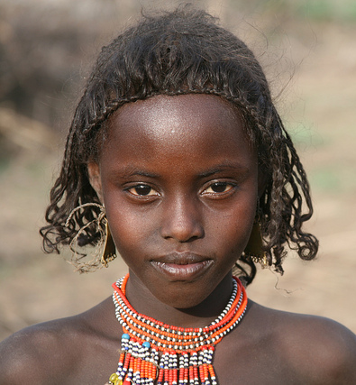
Violence against women and girls
Any act of GBV that results in, or is likely to result in, physical, sexual, or psychological harm or suffering to women or girls, including public or private:
threats of such acts
coercion
arbitrary deprivation of liberty
VAWG involving someone with whom s/he is an intimate relationship (husband, boyfriend, girlfriend, etc., is referred to as intimate partner violence (IPV).
Afari Girl, Ethiopia
©2008 Jhpiego
Notes:
Facilitator discussion points
Read the information on the slide.

Slide 14
Gender and sexual diversity.

Slide 15
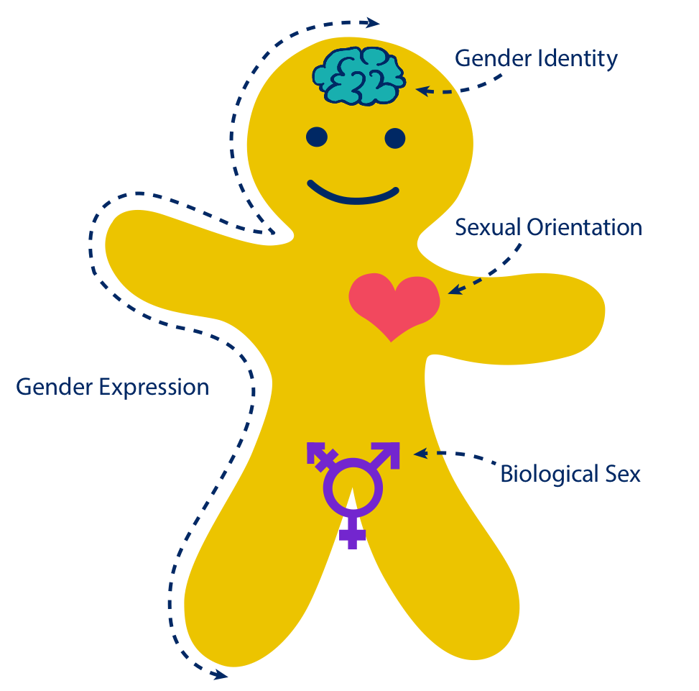
Genderbread Person
Notes:
Facilitator discussion points
Now we are going to learn about the Genderbread Person and the differences between gender identity, sexual orientation, gender expression, and biological sex.

Slide 16
Medical term referring to the chromosomal, hormonal, and anatomical characteristics used to classify an individual as female, male, or intersex
Intersex: general term used for a variety of conditions in which a person is born with a reproductive or sexual anatomy that doesn’t seem to fit the typical definitions of female or male
Female
Male
Notes:
Facilitator discussion points
Read the definition of biological sex.
Click, and read the definition of intersex.
Click to move the dot along the continuum, and explain that biological sex is on a continuum. The left side of the continuum refers to people who are born female meaning they are born with female sexual and reproductive organs (e.g., vagina, ovaries, etc.) and they have a biologically female “configuration” (e.g., two X chromosomes).
The far right side of the continuum refers to people born male, meaning they are born with male sexual and reproductive organs (e.g., testes, penis, etc.) and they have a biologically male “configuration” (e.g., XY chromosomes).
In the middle of the continuum are people who are born intersex. The term “hermaphrodite,” which many people use to describe an intersex individual, is a negative term that should not be used. An intersex person could be born with a combination of female and male sexual and reproductive organs—for example, a person can be born with the appearance of being physically male (penis, scrotum, etc.) but have a functional female reproductive system inside. There are many ways intersex can present itself.

Slide 17
Gender norms: culturally defined set of roles, responsibilities, rights, entitlements, and obligations associated with being female and male, as well as the power relations between and among women and men, boys and girls
External display of one’s gender through a combination of appearance, disposition, social behavior, and other factors
Generally measured on a scale of masculinity and femininity
Notes:
Facilitator discussion points
Read the definition of gender expression.
Click to move the dot along the continuum and explain that gender expression is also on a continuum. The left side refers to people who express who they are in a feminine way, by following the messages society communicates about the way women and girls should behave, dress, think, etc. The right side refers to people who express themselves in a masculine way, by following the messages society communicates about the way boys and men should behave, dress, think, etc. Some people may express themselves in ways where they combine both feminine and masculine characteristics—we refer to them as “androgynous.”
Our gender expression changes from year to year, month to month, even day to day, and we don’t even think about it. For example: You are a girl. When you leave the house in the morning you are wearing a dress and you make sure to have breakfast ready for your siblings—your gender expression is very feminine and you are very much on the left side of the continuum. At school that same day, you lead a student meeting because you are the class president—here your gender expression leans toward what is perceived as male, e.g., leading a group, being very vocal. You return home at the end of the day and immediately start helping your mother in the kitchen while your father and brothers watch television—you are back to playing a traditionally feminine role again.
Click and read the definition of gender norms.

Slide 18
Woman
Man
✓
Sex assigned at birth:
Female
Male
Transgender: umbrella term referring to an individual whose gender identity is different from their sex assigned at birth
transgender woman
A person’s deeply felt internal and individual experience of gender
May or may not correspond with the sex assigned at birth
Notes:
Facilitator discussion points
Read the definition of gender identity.
Click and read the definition of transgender.
Click (to reveal the red check mark on the box labeled “Male”) and explain that, for example, if someone is assigned male sex at birth, and their gender identity is woman, they can be considered a transgender woman. Click to reveal the words “transgender woman.”
Explain that gender identity is on a continuum. The far left side of the continuum refers to people who identify with the roles society has set for women, whereas the right side refers to people who identify with the roles society has set for men. Everyone forms their gender identity at around the age of 3 and after that age it is very difficult to change the identity. Our gender identity is formed by the influence of biology, society, and events in our lives.

Slide 19
Heterosexual
Homosexual
Heterosexuality: enduring emotional, romantic, or sexual attraction primarily or exclusively to people of a different gender; people who are heterosexual often identify as “straight”
Enduring emotional, romantic, or sexual attraction primarily or exclusively to people of a particular gender
Notes:
Facilitator discussion points
Read the definition of sexual orientation.
Click and read the definition of heterosexuality.
Click to move the dot along the continuum, and explain that sexual orientation is on a continuum.
Explain that people often get “gender” and “sexual orientation” confused. Gender has to do with how you express yourself as a man or a woman, whereas sexual orientation has to do with whom you are attracted to sexually and romantically. We often falsely assume that a man who is considered tough must be straight, or that a man who is considered sensitive must be gay. However, the exact opposite could be true, because gender roles and sexual orientation are two totally different things.
Some people are asexual, meaning they are not sexually attracted to anyone and/or have no desire to act on their attraction to anyone. Sometimes, however, asexual people experience affectionate/romantic attraction to others.
Some people do not like labels and do not use them to define their sexual identity. Others identify as “questioning,” a term used to describe a person who is unsure of or exploring her/his sexual orientation.
Sexual orientation is not a choice. We do not choose to be either gay, lesbian, bisexual or heterosexual.

Slide 20
Transgender
Notes:
Facilitator discussion points
This is the Genderbread Person. Now you should understand all of the concepts presented here. It is important to remember that gender identity, gender expression, biological sex, and sexual orientation do not determine one another. Gender identity and expression are not signs that a person is gay or heterosexual. A person’s biological sex does not determine their gender identity or how they express their gender (e.g., a transgender person).

Slide 21
Notes:
Facilitator discussion points
Gender identity, gender expression, biological sex, and sexual orientation are all on continuums. This is an example of where someone may fall on the four different continuums.

Slide 22
LGBT
Lesbian, gay, bisexual, and transgender
Commonly used to refer to gender and sexual minority communities
Variations exist that add, omit, or reorder letters
LGBTI
LGB
GLBT
Notes:
Facilitator discussion points
Read the information on the slide.

Slide 23
MSM
Men who have sex with men
Men may be considered MSM if they engage in sex with other men, regardless of whether or not they identify as gay or bisexual
Notes:
Facilitator discussion points
Read the information on the slide.

Slide 24
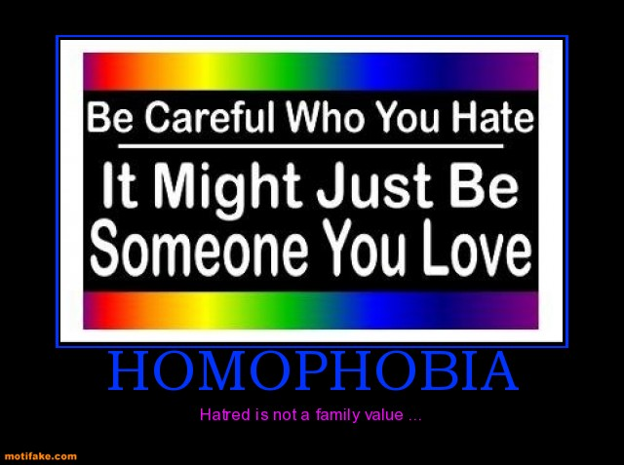
Homophobia and heterosexism
Homophobia
Fear and hatred of or discomfort with people who are attracted to members of the same sex
Heterosexism
Presumption that everyone is heterosexual and/or the belief that heterosexual people are naturally superior to homosexual and bisexual people
Notes:
Facilitator discussion points
Read the information on the slide.

