Slide 1
Moving toward gender-transformative programming: the gender equality continuum

Slide 2
Integrating gender
During all phases of programming:
Assessment
Goal setting
Program design and adaptation
Organizational/staff capacity-building and commitment
Program implementation
Program evaluation (process and outcome)
Quality improvement
Sustainability
Notes:
Facilitator discussion points
Ideally, gender should be integrated into a project/program from the start. It should be a key consideration at every stage of the program cycle—from design, to implementation, to monitoring and evaluation.
A gender analysis should be included as part of the program’s baseline in order to collect gender data that will be used to inform program design, namely goal setting and identification of activities and strategies/approaches.
Programmatic gender integration requires that staff have the capacity to address gender and that measures are included—as part of the programmatic design—to develop/strengthen staff and organizational capacity to address gender.
Gender remains a key consideration during implementation. Program teams must continuously monitor activities to ensure the desired outcomes are being achieved in terms of gender promotion and, importantly, that the program is not causing undue harm by exacerbating harmful gender norms. Regular monitoring also contributes to quality improvement through the continuous adaptation of program strategies and activities based on lessons learned during implementation.
Ultimately, integrating gender into a program contributes to impact because the program has included strategies aimed at shifting social and structural-level inequalities hindering women’s/girls’ and men’s/boys’ ability to equally benefit from the program.

Slide 3
Rationale
Gender norms have a powerful influence on health behavior
Gender norms can be changed
Changing harmful gender norms can lead to more sustained change
Ignoring or exploiting harmful gender norms may undermine program efforts
Notes:
Facilitator discussion points
Gender is a key health determinant. Women’s and men’s social, economic, and political status influence their respective access to health services, as well as their capacity to make choices and decisions about their health. This is why addressing gender norms in our programming is important for promoting health.
Programs that address gender norms rest on the premise that gender norms can be transformed, and that this transformation is necessary for programs to achieve lasting change. On the other hand, programs that either ignore gender norms or use them to achieve their objectives may not only undermine their effectiveness, but also cause harm to those they are intended to serve.

Slide 4
Notes:
Facilitator discussion points
Gender-blind programs do not consider the gender norms that characterize the social environment and the ways in which they might affect program/project participants. Gender-blind programs/policies do not consider how gender norms and unequal power relations affect the achievement of project objectives, or what impact the project objectives might have on gender norms and unequal power relations.
Gender-aware programs are designed to take advantage of existing gender norms and power relations, accommodate for them, or transform them. Programs may have multiple components that fall at various points along the continuum, which is why there are multiple arrows in the graphic. The ultimate goal of development programs is to achieve health outcomes while transforming gender norms in order to achieve greater equality between women and men. The part of the arrow related to “transformative” is green to signal that it is okay to proceed. The arrow then extends indefinitely toward greater equality (beyond the arrow). Gender-aware programs can be categorized as gender exploitative (taking advantage of existing harmful gender norms), gender accommodating (working around harmful gender norms without striving to challenge or change them), or gender transformative (actively addressing harmful gender norms and working to change them).

Slide 5
Gender blind
Little or no recognition of gender norms and relations in program or policy design, implementation, or evaluation
Gender has not been considered
Children in Albania, Photo ©2010, Jhpiego
Notes:
Facilitator discussion points
Gender blind means there is no consideration of the gender norms that characterize the social environment and the ways in which they might affect program/project participants. Gender-blind programs/policies do not consider how gender norms and unequal power relations affect the achievement of project objectives, or what impact the project objectives might have on gender norms and unequal power relations.

Slide 6
Gender blind example
Dominican Republic: sex education for youth
Strategies:
Curricula address several important psychosocial determinants of delaying sex and using condoms, such as knowledge about HIV, attitudes about abstaining from sex, and correct use of condoms.
There is no mention of how gender norms affect attitudes, condom use, or sexual decision-making.
Results:
Curriculum was effective at increasing condom use among sexually active youth.
Boys still dominate decisions about when and where to have sex; girls do not feel empowered to negotiate.
Notes:
Facilitator discussion points
A health project in the Dominican Republic was concerned about rising sexually transmitted infection (STI) and pregnancy rates among youth. The project decided to recruit volunteer peer educators to conduct charlas, or informal discussion groups. Generally, youth have a hard time discussing sexual and reproductive health issues. Peer educators ran afterschool neighborhood youth charlas in mixed-sex groups to discuss issues related to dating, relationships, reproductive health, and contraception (including condoms). They also provided information on where contraceptives could be obtained. However, participation in the discussion groups was very low.
The evaluation found that the low participation was due to boys’ and girls’ fear of talking about sexual and reproductive health in front of the opposite sex.
The curriculum was effective at increasing condom use among sexually active youth. However, boys still dominate decisions about when and where to have sex; girls do not feel empowered to negotiate safer sex.
A key reason for the gender-blind approach is that the project did not consider gender dynamics when designing the project, as described here.

Slide 7
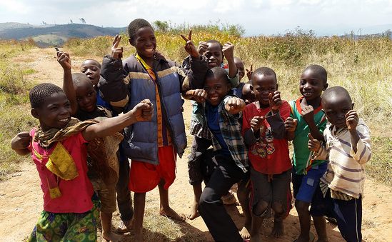
Gender exploitative
Takes advantage of harmful, inequitable gender norms and existing imbalances of power
Can result in harmful consequences and undermine a program’s intended objective
Boys in Malawi, Photo ©2014 by Jennifer Berg/Jhpiego
Notes:
Facilitator discussion points
Gender-exploitative programs (on the left of the continuum) take advantage of rigid gender norms and existing imbalances in power to achieve the health program’s objectives.
Although using a gender-exploitative approach may seem expeditious in the short run, it is unlikely to contribute to sustainable results and can, in the long run, result in harmful consequences and undermine the program’s intended objective. Gender-exploitative programs are unacceptable. Under no circumstances should programs take advantage of existing gender inequalities in pursuit of health outcomes (“Do no harm!”).

Slide 8
Gender exploitative example
Zimbabwe family planning campaign
The campaign used sports images and metaphors to communicate the importance of men’s participation in family planning (FP) decision-making. Messages included:
“Play the game right. Once you are in control, it’s easy to be the winner!”
“It’s your choice.”
Contraceptive use went up in the community.
Men interpreted the campaign as promoting the notion that FP decisions should be made by men alone.
Notes:
Facilitator discussion points
In an effort to increase contraceptive use and male involvement in Zimbabwe, a family planning project initiated a communication campaign promoting the importance of men’s participation in family planning decision-making.
Messages relied on sports images and metaphors, such as “Play the game right. Once you are in control, it’s easy to be a winner” and “It is your choice.”
The campaign increased the use of contraceptive methods. When evaluating impact, the project asked male respondents whether ideally they, their partners, or both members of the couple should be responsible for making family planning decisions.
The evaluation found that: “Whereas men were far more likely to believe that they should take an active role in family planning matters after the campaign, they did not necessarily accept the concepts of joint decision-making. Men apparently misinterpreted the campaign messages to mean that family planning decisions should be made by men alone.”

Slide 9
Gender accommodating
Acknowledges the role of gender norms and inequities
Includes activities to adjust to and/or compensate for gender norms and inequities
Does not actively aim to change norms, but strives to limit the impact of harmful gender norms
Can provide a sensible first step toward gender-transformative programming
Ethiopian children
Photo ©2004 M. McNabb/Jhpiego
Notes:
Facilitator discussion points
Gender-accommodating programs (in the middle of the continuum) acknowledge the role of gender norms and inequities and seek to develop actions that adjust to and often compensate for them. In essence, gender-accommodating projects maintain gender dynamics and roles in order to achieve project outcomes. Although such projects do not actively seek to change the norms and inequities, they strive to limit their harmful impacts on gender relations.
A gender-accommodating program may be considered a missed opportunity because it does not deliberately contribute to increased gender equity, nor does it address the underlying social, political, and economic factors that perpetuate gender inequities. However, in social and cultural contexts where gender norms remain a highly sensitive issue, gender-accommodating approaches often provide a sensible first step to gender integration because they strive to ensure that all project participants can equally benefit from the project’s efforts.

Slide 10
Gender accommodating example
Engaging fathers in India
A multipronged program to improve maternal and child health in several Delhi slums works on diarrheal case management, increasing institutional births, and increasing immunization, among other things.
The program also reaches out to men since they often control decision-making in the home.
The program runs local TV ads for services, encouraging men to support their partners in taking children for prevention and treatment, and also runs prevention messages directed at men and women. The program reaches out to religious leaders and men at mosques on the need to take their wives for services.
Notes:
Facilitator discussion points
Although the program made efforts to involve men in maternal and child health, it did so by maintaining and accommodating for the dominant gender norm that men are the heads of the household.
The program recognized men as the decision-makers and chose to influence men’s decision-making role in a manner that would support maternal and child health; however, the project did doing nothing to challenge men’s position as decision-makers, or to advance the idea that women should be able to make decisions about their own health.

Slide 11
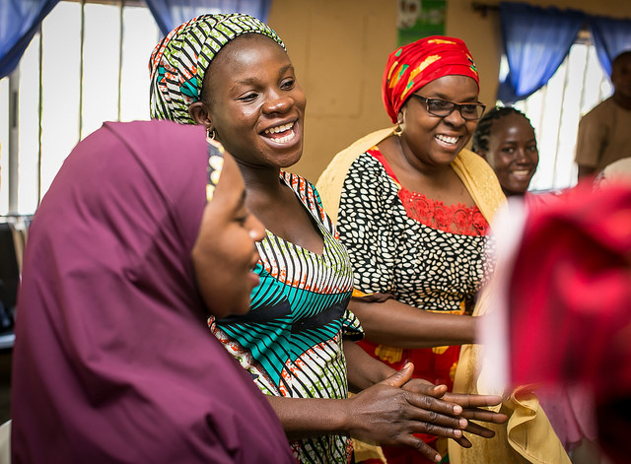
Gender transformative
Raises awareness about, examines, questions, and redefines gender norms
Examines the vulnerabilities and costs of rigid gender norms for both men and women
Examines how gender norms influence health
Aims to change rigid and harmful gender norms
Addresses imbalances in power and promotes equitable relationships
Uses an ecological model
Women in Akwanga, Nigeria
Photo ©2017 by Paul Joseph/Jhpiego
Notes:
Facilitator discussion points
Gender-transformative programs (at the right end of the continuum) actively strive to examine, question, and change harmful gender norms and power imbalances between women and men as a means of achieving positive health outcomes as well as gender equity.
Gender-transformative approaches encourage critical awareness among men and women of gender roles and norms; promote the social, economic, and political positioning of women; challenge the unequal distribution of resources and allocation of duties between women and men; and/or address the power relationships between women and others in the community, such as service providers and traditional leaders.

Slide 12
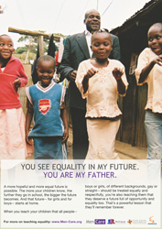
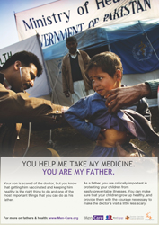
Gender transformative example
Global MenCare campaign
Source: http://men-care.org
Notes:
Facilitator discussion points
MenCare is a global fatherhood campaign. Its mission is to promote men’s involvement as equitable, nonviolent fathers and caregivers in order to achieve family well-being and gender equality. Through media, program development, and advocacy, the campaign works at multiple levels to engage men as caregivers and as fathers, as program participants in fathers’ groups, and as community mobilizers who push for progressive family legislation; and institutions, including health services, to see engaging men as caregivers as a key dimension of gender equality. Health providers are trained and supported to actively encourage men in antenatal care, in the delivery room, where appropriate, and in kangaroo father care.
The campaign is gender transformative because it is challenging dominant and traditional norms related to men’s involvement in parenting and reproductive and maternal health. By encouraging men’s positive and active involvement in childcare and parenting, the campaign is challenging dominant gender roles.
The campaign is also gender transformative because it has adopted an ecological approach, meaning that it is working at various levels (individual, community, institutional) to challenge gender norms.
In Rwanda, the campaign, combined with group dialogues on gender norms resulted in substantial improvements in multiple reported outcomes. Compared to the control group, women in the intervention group reported:
less past-year physical (OR 0.37, p<0.001) and sexual IPV (OR 0.34, p<0.001); and greater attendance (IRR 1.09, p<0.001) and male accompaniment at antenatal care (IRR 1.50, p<0.001);
and women and men in the intervention group reported: less child physical punishment (women: OR 0.56, p = 0.001; men: OR 0.66, p = 0.005);
greater modern contraceptive use (women: OR 1.53, p = 0.004; men: OR 1.65, p = 0.001); higher levels of men’s participation in childcare and household tasks (women: beta 0.39, p<0.001; men: beta 0.33, p<0.001);
and less dominance of men in decision-making.
Methods: conducted a multi-site randomised controlled trial in four Rwandan districts with expec tant/current fathers and their partners, who were randomised to the intervention (n = 575 couples) or control group (n = 624 couples). 1123 men and 1162 partners were included in intention to treat analysis.

Slide 13
Moving from accommodating to transformative
In countries such as Kenya, Rwanda, Tanzania, and Zambia, prevention of mother-to-child transmission of HIV (PMTCT) policies encourage men to get tested for HIV and participate in antenatal care by:
Encouraging women to bring their partners to the health facility in succeeding visits
Sending letters inviting partners to the next antenatal care visit where men are counseled and tested for HIV as are women
Notes:
Facilitator discussion points
In seeking to be accommodating (by working around existing gender norms and power dynamics), many programs have ended up being exploitative because providers misunderstood the policy and either refused services to women who didn’t come with a partner, or prioritized women who came with their partner. Programs should continuously monitor the impacts of their strategies/activities on program participants so as to avoid causing harm.
PTMCT programs can become transformative in several ways.

Slide 14
Moving from accommodating to transformative (continued)
Ensure equal access to PMTCT, antenatal care, FP, and the range of services regardless of whether the partner is present (and not just engage men to be tested for HIV).
Encourage male partners to be involved to facilitate discussions and joint decision-making with respect to antenatal care, FP, etc.
Train providers to engage and enlist men not only to be tested for HIV but also to be engaged and supportive partners in antenatal care, birth planning, and postnatal care (e.g., kangaroo father care).
Notes:
Facilitator discussion points
Kangaroo care is a baby-holding technique that involves skin-to-skin contact. Encouraging this practice among men helps to strengthen the bond between fathers and their babies.

Slide 15
Group exercise
Accommodating, transformative, or exploitative?
Notes:
Facilitator discussion points
We will look at two more project examples and decide together where they are located on the continuum.

Slide 16
Care and support for people living with HIV/AIDS
This program was designed to increase youths’ involvement in providing support and care for people living with HIV/AIDS (PLHIV).
Male and female youths were asked what support and care tasks they were comfortable providing.
PLWHA were asked what tasks they would prefer a male or female to provide
The project used this data to develop support activities that would specifically be carried out by girls and others that would be carried out by boys

Slide 17
Gender blind

Slide 18
Answer: accommodating
Notes:
Facilitator discussion points
The program is accommodating because it maintained and worked around existing norms related to socially accepted roles for girls and boys. The program did not seek to challenge girls’ and boys’ socially ascribed roles.

Slide 19
Youth outreach
An education project was concerned about rising STI and pregnancy rates among youth.
The project decided to recruit female and male peer educators to lead afterschool groups. Groups discussed issues related to dating, relationships, reproductive health, and abstinence.
Through participatory activities, girls and boys explored gender roles, role-played positive behaviors, and learned how to make informed reproductive health decisions that respect the rights of others and themselves.

Slide 20
Gender blind

Slide 21
Answer: transformative
Notes:
Facilitator discussion points
This project was transformative because it challenged social norms around sexuality by bringing boys and girls together to talk about reproductive health. By encouraging participants to reflect on gender norms and reproductive rights, the project may also have contributed to making power dynamics in intimate relationships more equitable.

