Slide 1
This is a summary of family planning investments collected from stakeholders across the four WABA/Amplify-FP countries. It is Appendix 4 of a report: Dougherty, Leanne, Martha Silva, and Kathryn Spielman. 2020. "Strengthening social and behavior change monitoring and evaluation for family planning in Francophone West Africa," Breakthrough RESEARCH Final Report. Washington DC: Population Council. Available at: http://breakthroughactionandresearch.org/wp-content/uploads/2020/04/WABA-FP-IndicatorMapping-Report.pdf

Slide 2


Family Planning Investments in Burkina Faso, Côte d'Ivoire, Niger, and Togo
April 2020

Slide 3
Breakthrough RESEARCH
USAID's flagship social and behavior change (SBC) research project
Five-year project (2017 to 2022)
Supported through USAID Global Health Bureau, cross-bureau, and mission-supported activities
Close collaboration with sister project Breakthrough ACTION and other implementing partners
Consortium of six partners

Slide 4
Background
Francophone West Africa has the highest fertility rates in the world and low contraceptive prevalence.
The Ouagadougou Partnership was established to accelerate progress in the use of family planning (FP).
However, efforts have focused on service delivery and commodity procurement with fewer investment in demand creation through SBC approaches.
The SBC Global Influence Strategy identified the following reasons for why there are fewer investments: (1) a lack of awareness that SBC is needed to improve outcomes and (2) a belief that SBC does not generate the same return on investment as other service delivery and procurement investment options.

Slide 5
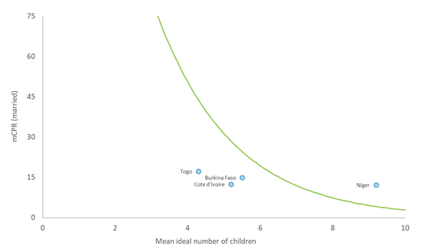
Not all countries may require equal investment in demand
The maximum contraceptive prevalence demand curve (mCPR) is a tool that helps us establish how much a country’s mCPR can expect to grow without further investment in demand creation. The potential use gap indicates where more demand-side interventions are needed to be able to improve mCPR. A small potential use gap indicates the need for demand-side investments to increase mCPR. A large potential use gap indicates the need to prioritize access investments to increase mCPR.
Niger has no potential use gap—without investing in demand generation there is limited potential to improve mCPR.
Burkina Faso has a modest potential use gap.
Côte d'Ivoire and Togo have a large potential use gap, indicating there is existing demand and there may be a need to focus more investments on supply.
Source: Weinberger M, et al. The maximum contraceptive prevalence ‘demand curve’: guiding discussions on programmatic investments. Gates Open Research. 1:15, 2017.

Slide 6
Purpose of FP investment mapping
Breakthrough RESEARCH gathered information from FP projects and donors as part of a broader set of activities focused on strengthening SBC monitoring and evaluation for FP in Francophone West Africa:
To provide a snapshot of FP investments by donor and type of investment in Burkina Faso, Côte d'Ivoire (RCI), Niger, and Togo
Country selection is based on current USAID FP investments through Breakthrough ACTION and Amplify-FP
This activity builds on the first version of the SBC FP Investment Database developed by the Bill & Melinda Gates Foundation

Slide 7
Process
1
Baseline document + online searches
Ouagadougou Partnership and stakeholder websites
2
Stakeholder interviews
Who is funding FP work in this setting?
3
Crosscheck with documents provided during stakeholder interviews
4
Validation
Have we missed anything?
Notes:
Baseline document = Catherine Harbour regional investment summary document mentioned in previous slide

Slide 8
Definitions
An FP investment is defined as a single or multi-donor project or initiative, funded by non-governmental sources, with the purpose of improving FP outcomes
Technical area types of investments
Supply side — designated to increase the availability and/or quality of FP services and commodities
Demand side — designated to increase the demand for FP and related services
Advocacy — designated to positively shift the enabling environment for FP
Research and measurement — primarily designated to improve the availability of data and evidence and their use for policy and program decision making
Multi-area investment — cover more than one technical area along the types of investments noted above

Slide 9
Limitations
This snapshot only reflects investments in the last five years.
It does not reflect the dollar amount of each investment, or the level of influence (potential or real) in these countries.
This document is based on stakeholder interviews in four countries, supplemented with online searches and a preliminary form of the SBC investment database. It is likely that some information was missed during the data collection process and the quality of information collected may not be complete, resulting in misclassifications.

Slide 10
Key
= past investment, active in the last 5 years
= current investment, still active
Overlapping circles = co-funded project
Regional investments = active in all 4 target countries
Sub-regional investment = active in 2–3 target countries

Slide 11
Key: Donors involved in the region
 | Advanced Family Planning |  |  | Dutch Cooperation |  |  | Private
 | Agence française de développement |  |  | European Union |  |  | SONGES/CDRI
 | Anonymous |  |  | GIZ |  |  | USAID
 | Belgian Cooperation |  |  | Hewlett |  |  | World Bank
 | Bill & Melinda Gates Foundation |  |  | KFW |  |  | UK Aid/DFID
 | Canadian Cooperation |  |  | SIDA |  |  | UNFPA
 |  |  |  |  |  |  | Unitaid

Slide 12
Overview of Investments

Slide 13
Summary of investments by country and type
Burkina Faso has by far the largest number of investments, while Togo has the least.
In all countries, most investments span more than one technical area
Notes:
Bar chart: Supply, demand, advocacy, research, "packages", by country
Observations: Greater number of investments in Burkina. The majority of investments in each country covered multiple areas.

Slide 14
Overview of next sections
Summary of FP investments in:
West Africa region
Burkina Faso
Niger
Côte d'Ivoire
Togo

Slide 15
West Africa Regional Investments

Slide 16
In the last 5 years we counted 25 West Africa regional or sub-regional investments, 17 of which included all 4 countries and 7 of which included only 2 or 3 countries. Of these investments, 11 have addressed FP supply, 12 have focused on demand, 9 on advocacy, and 6 on measurement.

Slide 17
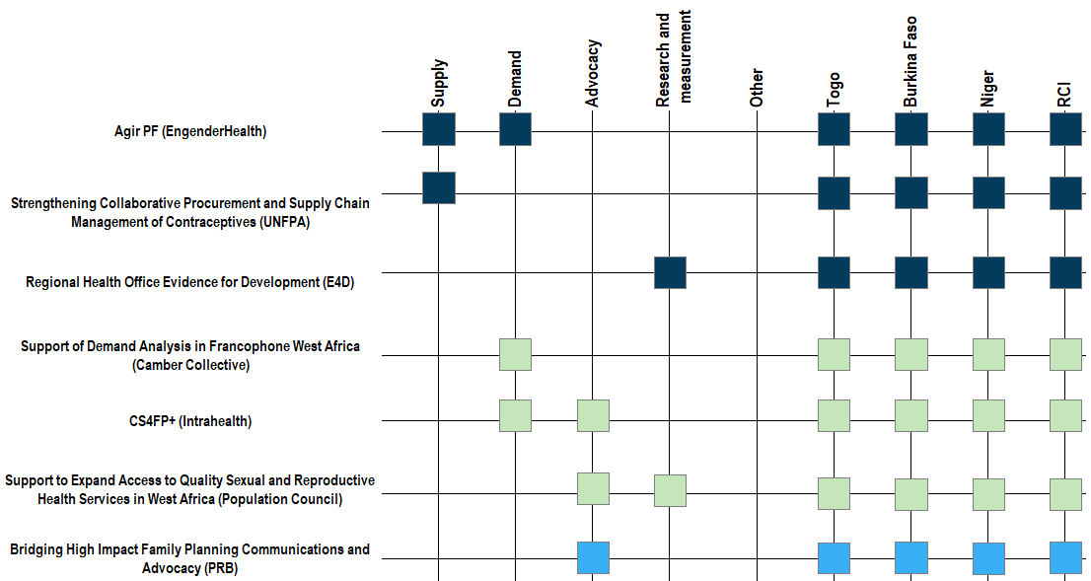
Investments that have ended in the last five years span all major technical areas
USAID
Hewlett
Bill & Melinda Gates Foundation
Closed investment

Slide 18
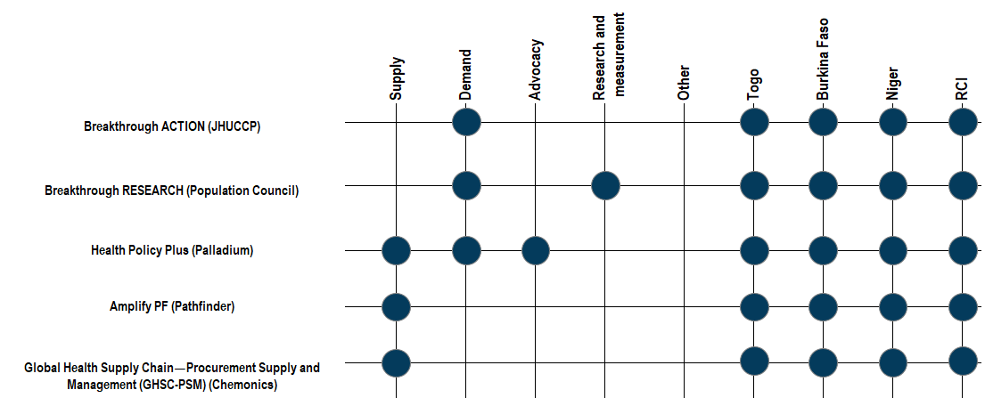
USAID’s current investments are balanced across technical areas, with a focus on supply and demand
USAID
Current investment

Slide 19
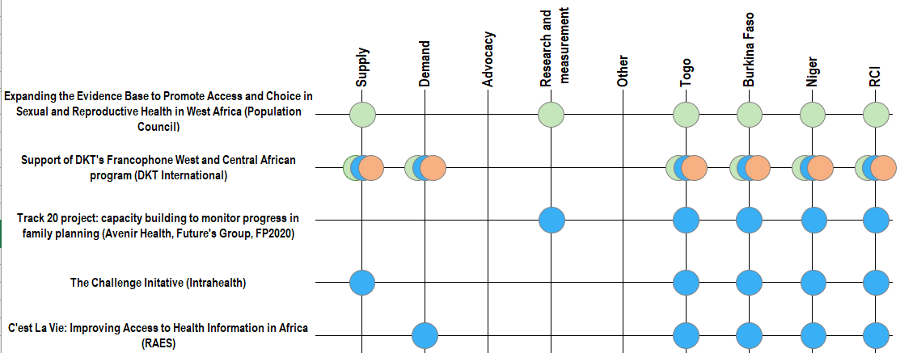
Other regional investments similarly focus mainly on supply and demand
Hewlett
Bill & Melinda Gates Foundation
Anonymous
Current investment

Slide 20
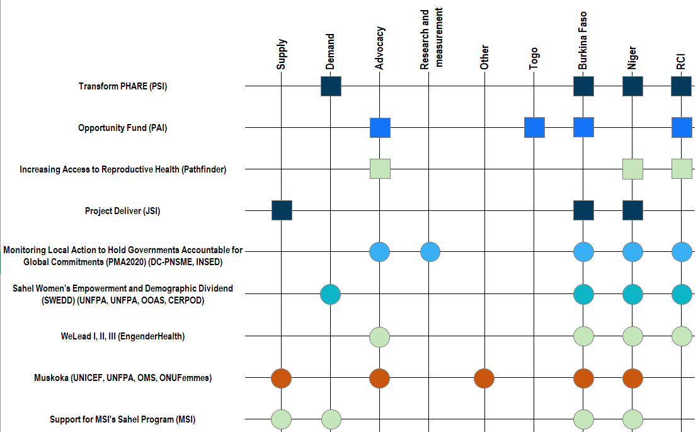
Sub-regional investments focus more heavily on advocacy
USAID
Advanced Family Planning
Hewlett
Bill & Melinda Gates Foundation
World Bank
Agence française de développement
Closed investment
Current investment

Slide 21
Burkina Faso investments
(excludes regional investments)

Slide 22
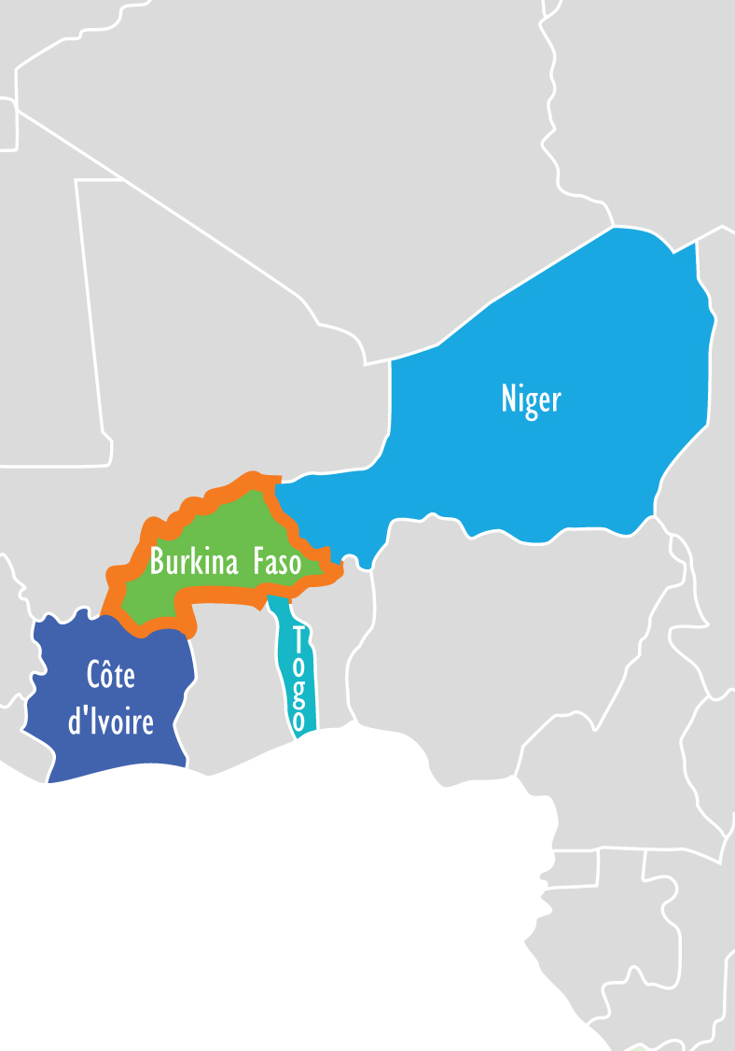
Burkina Faso
TFR**: 5.2
mCPR*: 30.7%
Total fertility rate among women 15–49
Married women using any modern method of contraception
Unmet need*:19.1%
Adolescent (15–19) preg**: 26.8%
Unmet need for contraception among all women
Percentage of teenagers who have started childbearing
Source: *2018 PMA Survey; **2017–2018 MIS

Slide 23
In the last five years we counted 27 investments in Burkina Faso, excluding regional investments. Of these investments, 12 have addressed FP supply, 14 have focused on demand, 13 on advocacy, and 3 on measurement. Burkina Faso has more investments compared to other countries and covers a balanced range of technical areas.

Slide 24
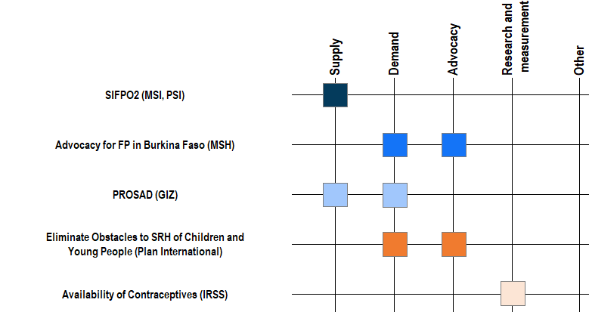
Investments that have ended in the last five years cover all major technical areas
USAID
Advanced Family Planning
Hewlett
Private
GIZ
UNFPA
Closed investment

Slide 25
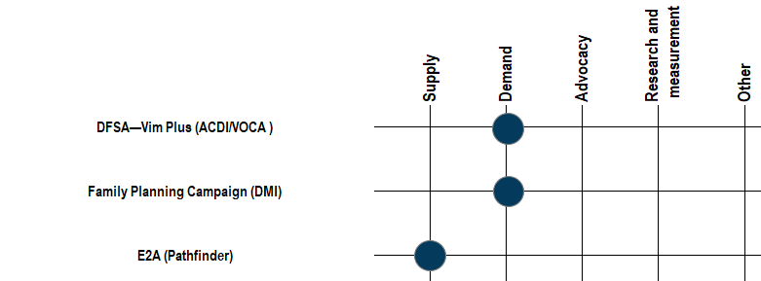
USAID’s non-regional investments in Burkina Faso focus on supply and demand
USAID
Current investment

Slide 26
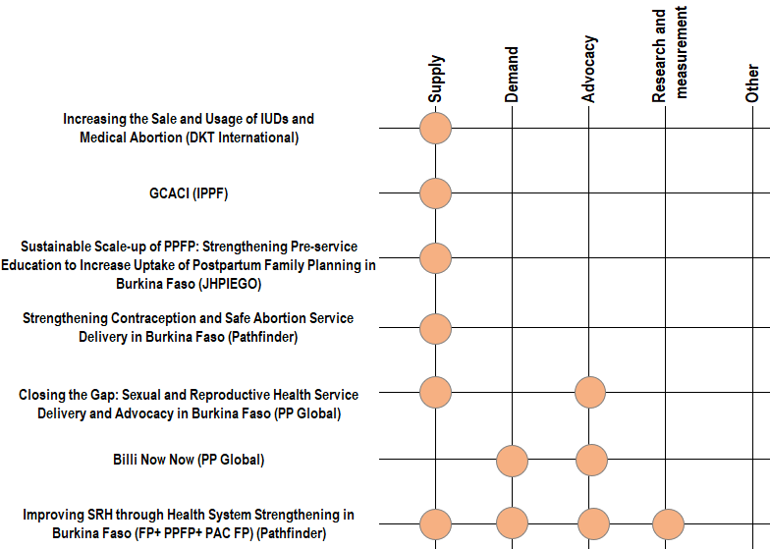
Anonymous donor has large number of investments in Burkina Faso, primarily for supply and advocacy
Anonymous
Current investment

Slide 27
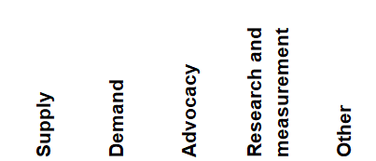
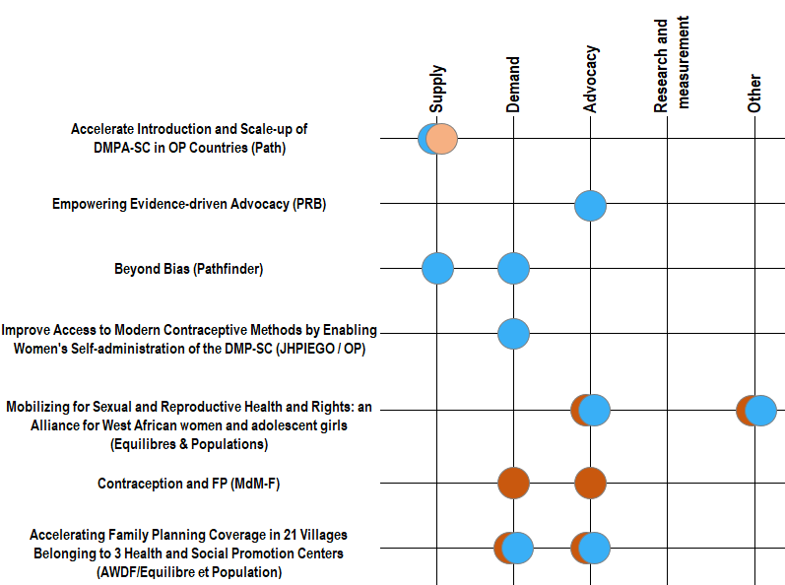
Accelerate introduction and scale-up of DMPA-SC in OP countries (Path)
Empowering Evidence-Driven Advocacy (PRB)
Beyond Bias (Pathfinder)
Improve access to modern contraceptive methods by enabling women's self-administration of the DMP-SC (JHPIEGO / OP)
Mobilizing for sexual and reproductive health and rights: an Alliance for West African women and adolescent girls (Equilibres & Populations)
Contraception and FP (MdM-F)
Accelerating family planning coverage in 21 villages belonging to 3 Health and Social Promotion Centers (AWDF / Equilibre et Population)
BMGF and AFD’s investments span multiple technical areas
Anonymous
Bill & Melinda Gates Foundation
Agence française de développement
Current investment

Slide 28
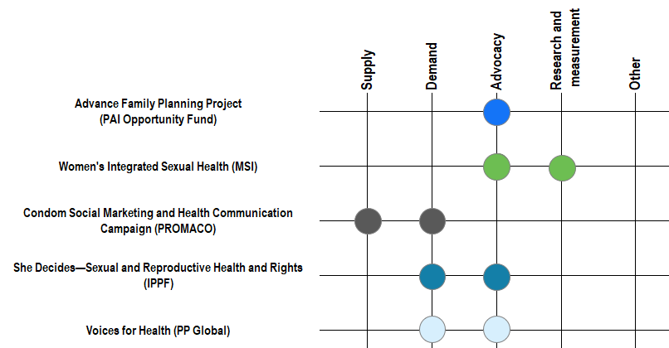
Burkina Faso has a diverse donor landscape
Advanced Family Planning
UK Aid/DFID
KFW
Belgian Cooperation
Private
Current investment

Slide 29
Niger investments
(excludes regional investments)

Slide 30
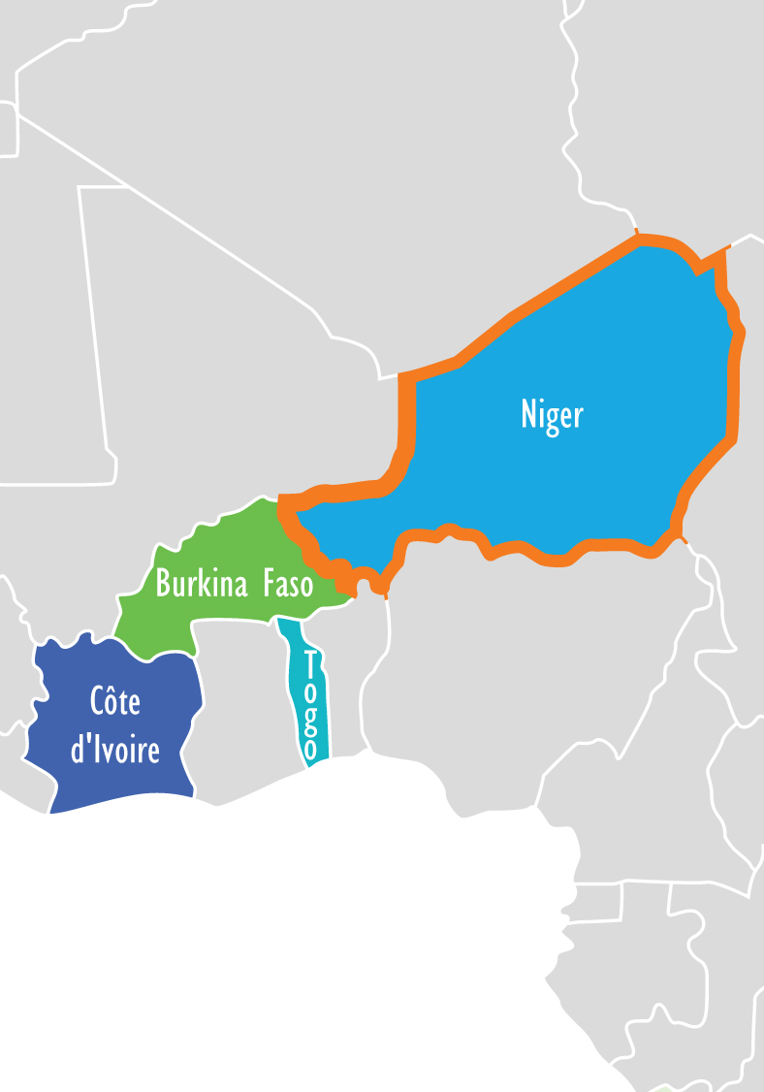
Niger
TFR*: 7.6
mCPR*: 12.2%
Total fertility rate among women 15–49
Married women using any modern method of contraception
Unmet need*:16.0%
Adolescent (15–19) preg*: 40.4%
Unmet need for contraception among all women
Percentage of teenagers who have started childbearing
Source: *2012 DHS

Slide 31
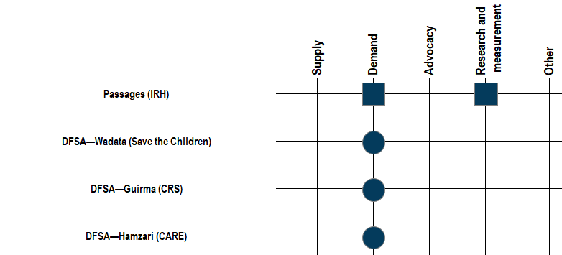
Investments in Niger are highly skewed toward demand side
USAID
Closed investment
Current investment
Notes:
Of the 9 (or 8) investments 7 are demand focused; again there are not many combined technical areas in a single project
USAID funds 4 of the investments.
*bulk of Niger investments are regional, fewer investments are country specific

Slide 32
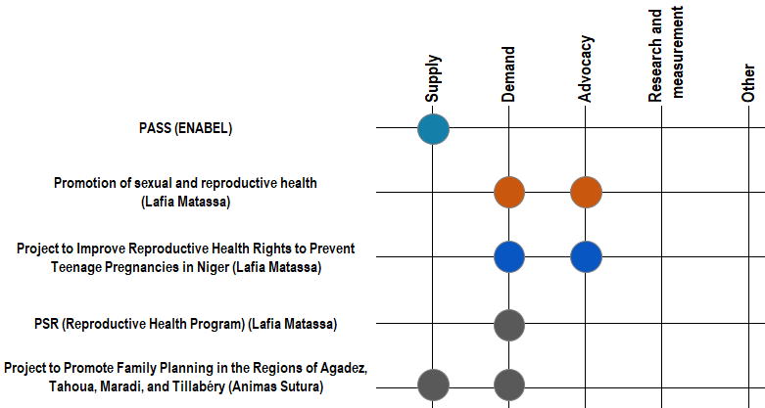
Research and measurement investments in Niger appear through regional investments and not country-specific ones
Belgian Cooperation
Agence française de développement
SONGES/CDRI
KFW
Current investment
Notes:
Songes/CDRI, KFW, AFD

Slide 33
Côte d'Ivoire investments
(excludes regional investments)

Slide 34
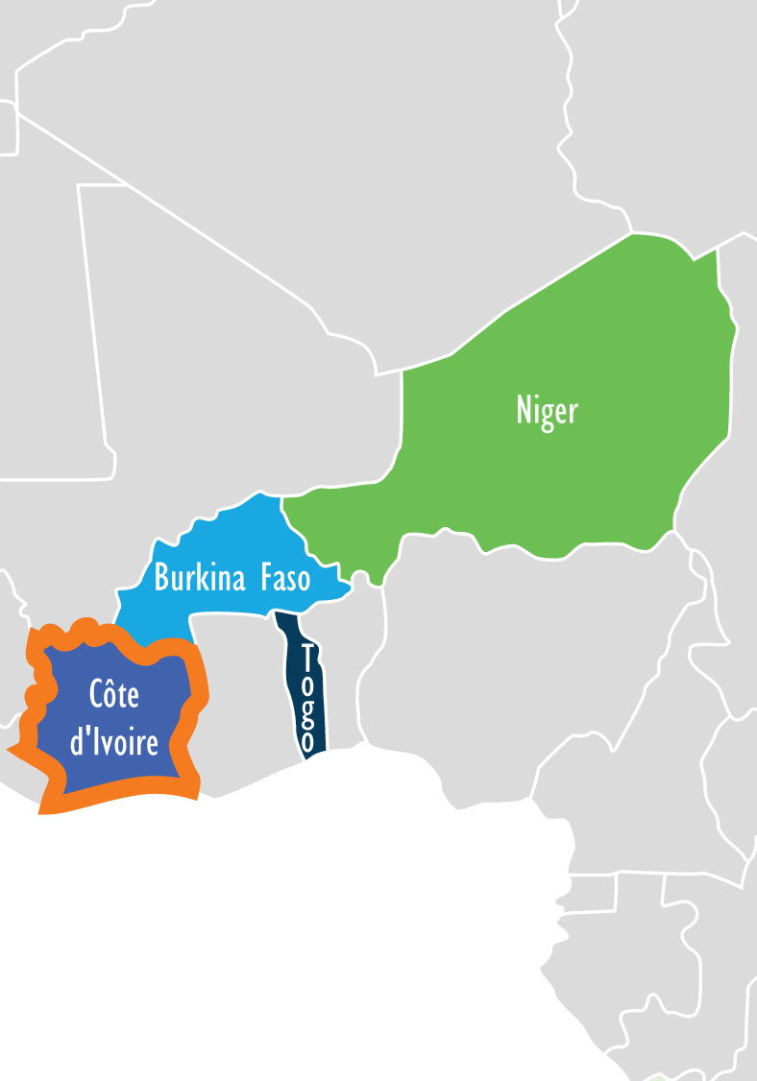
Côte d'Ivoire
TFR**: 5.0
mCPR*: 19.6%
Total fertility rate among women 15–49
Married women using any modern method of contraception
Unmet
need*:22.5%
Adolescent (15–19) preg**: 29.6%
Unmet need for contraception among all women
Percentage of teenagers who have started childbearing
Source: *2018 PMA Survey; **2011–2012 DHS

Slide 35
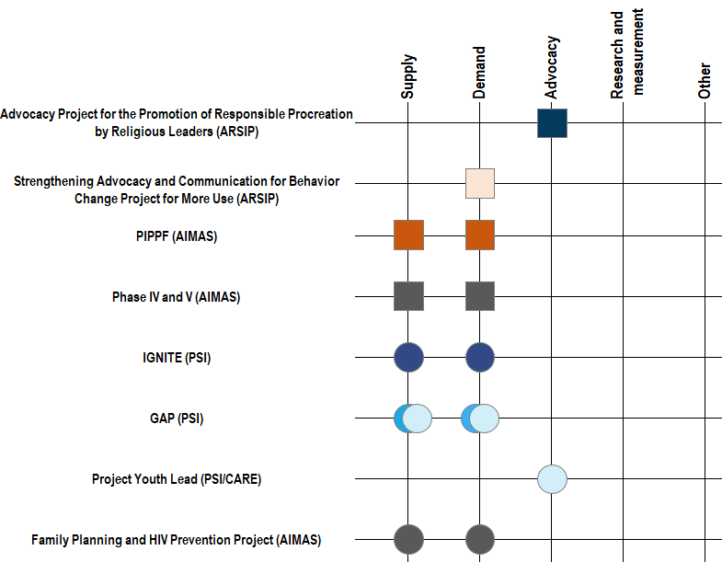
RCI has diverse donor landscape, with almost equal emphasis on demand and supply and fewer investments on advocacy, research & measurement
USAID
UNFPA
Agence française de développement
KFW
Dutch Cooperation
Canadian Cooperation
Private
Closed investment
Current investment

Slide 36
Togo investments
(excludes regional investments)

Slide 37

Togo
TFR*:4.4
mCPR**: 17.3%
Total fertility rate among women 15–49
Married women using any modern method of contraception
Unmet
need**: 33.6%
Adolescent (15–19) preg*: 18.6%
Unmet need for contraception among all women
Percentage of teenagers who have started childbearing
Source: *2017 MIS; **2013–14 DHS

Slide 38
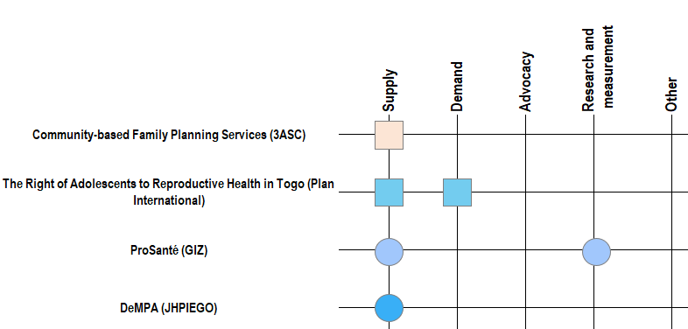
Togo has the fewest investments; non-regional investments are skewed heavily toward supply side.
UNFPA
European Union
GIZ
Bill & Melinda Gates Foundation
Closed investment
Current investment
Notes:
Togo has the fewest investments; all of which have a supply component; there is no advocacy
*Engender; technical note that the project is starting in Togo and then will reach other countries (no timeline mentioned)

Slide 39
Questions for consideration/discussion
Donors:
What do donors need to know about previous investments, their performance, and how patterns of investment evolved over time?
Where are donors collaborating and around what type of activities?
How can donors create more and better synergies to leverage investments?
What can we learn about different donors’ investment approaches?
When does it make more sense to invest regionally versus at a country-specific level?

Slide 40
Questions for consideration/discussion
Governments
To what extent does the information collected reflect the current environment?
How can Ouagadougou Partnership countries make use of this information?

Slide 42
Technical Notes
Missing due to incomplete information:
MSI (Access) was omitted due to lack of information about countries of focus
Slide 17 – EngenderHealth (Program and Strategy in West Africa)
Slide 21 – UNFPA (Bringing communication and advocacy related to FP)
Slide 24 – MSI (Support for HCD)
Slide 27 – I3S (Implementation of a comprehensive sexual and reproductive health strategy) is missing due to incomplete information
Slide 31 – EngenderHealth (Amplify the voices of girls and women living in Côte d'Ivoire for quality access to SRH services)

